Slide 1
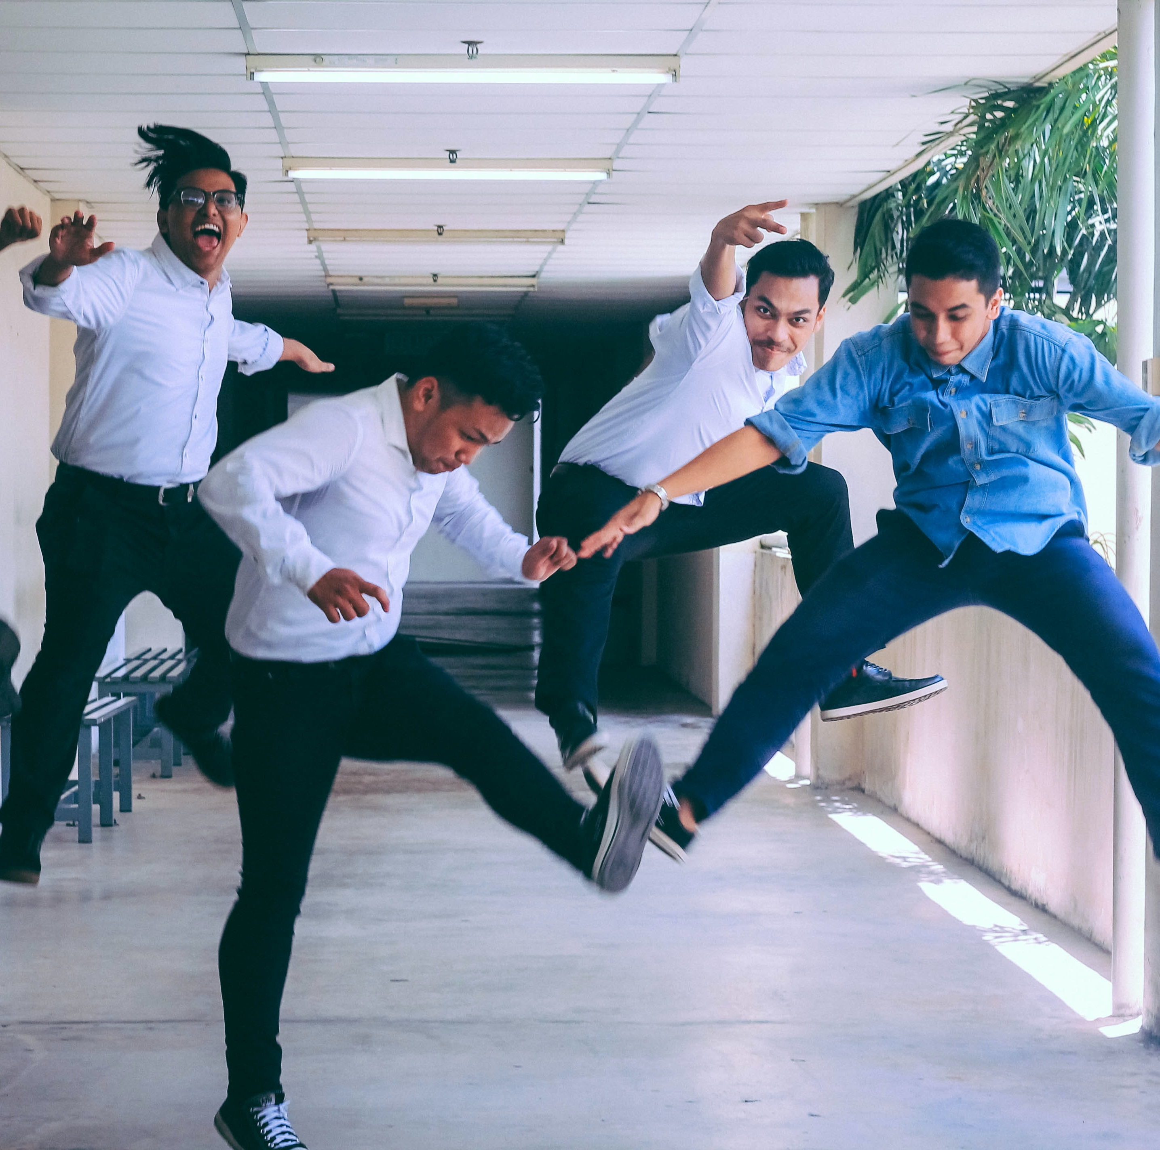
The CiscoPavelka Global Challenge 2022 is here!

Slide 2
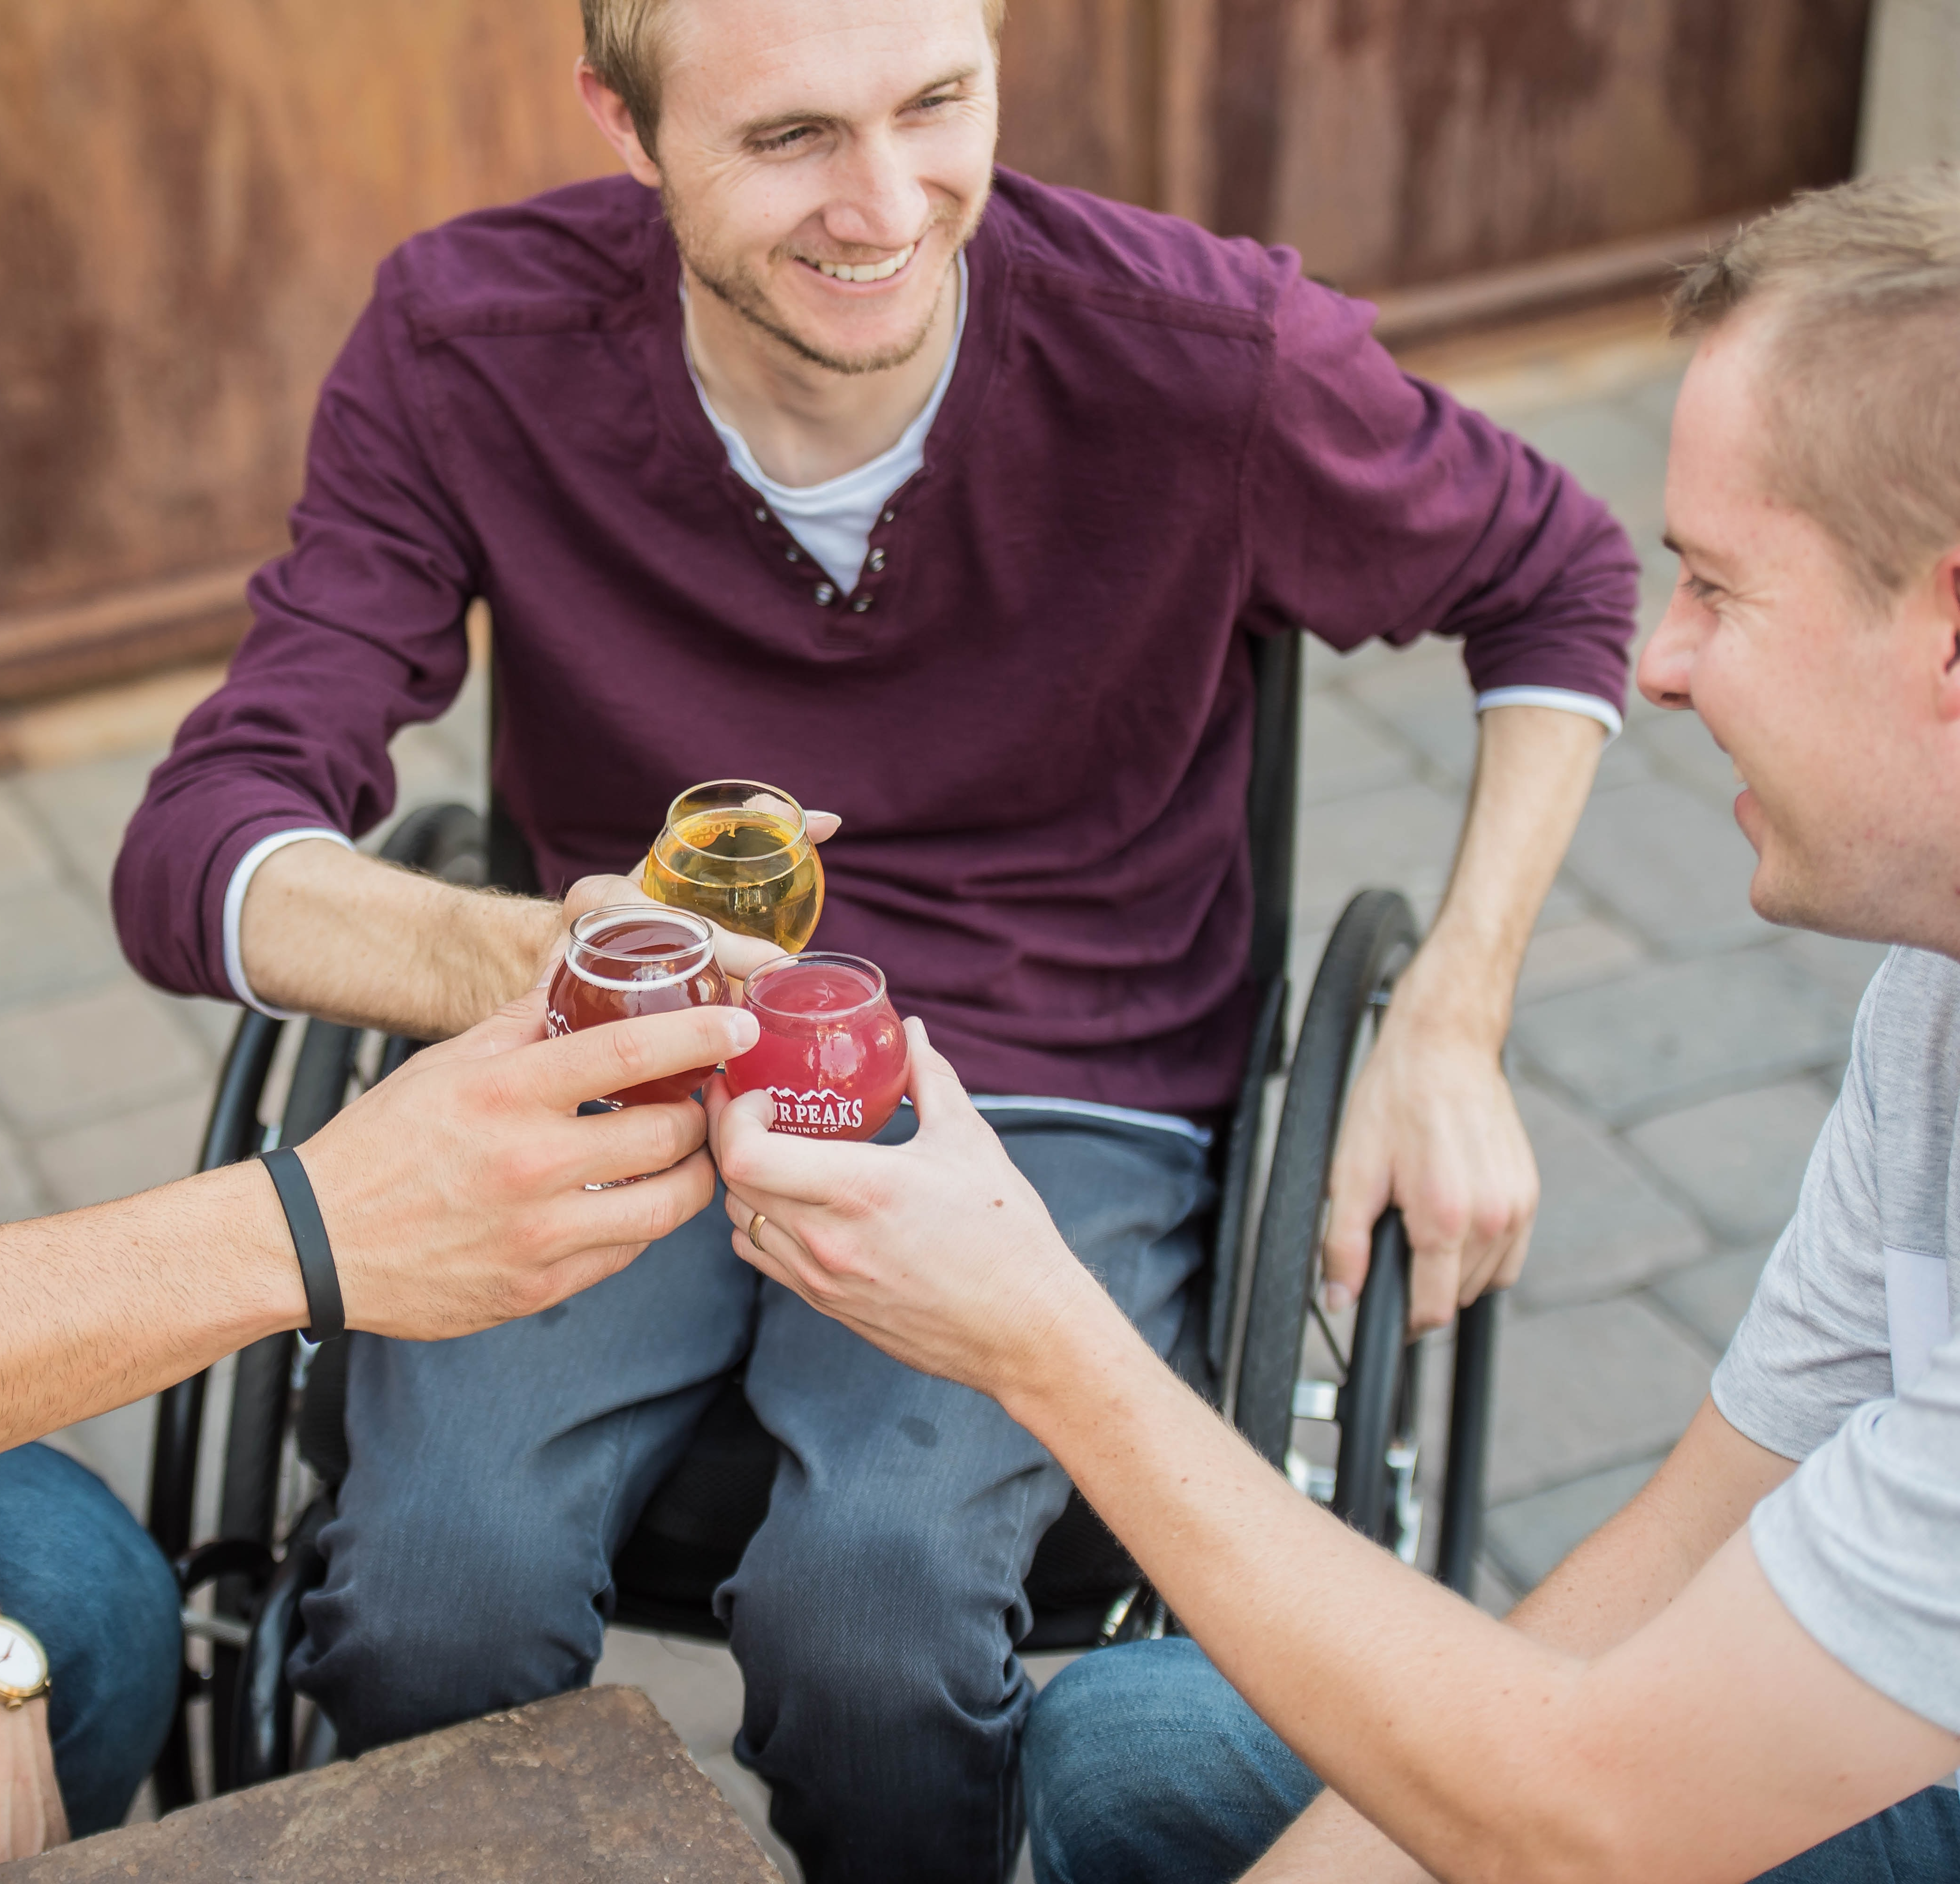
This is who you can be
This is how you connect
Join the Global Challenge and build real connections with your colleagues. Get involved and have fun!
Give your teammates a lift each day as you check in with each other. Level up their well-being!
This is where healthy
collaboration happens
Build your leadership and teamwork skills in a healthy way! For leaders, this is your opportunity to focus on your team’s connection and well-being.

Slide 3
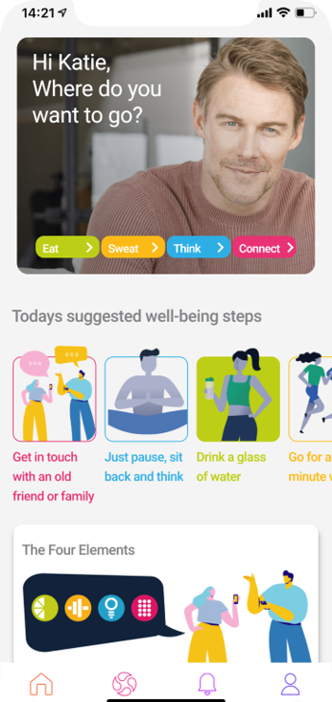
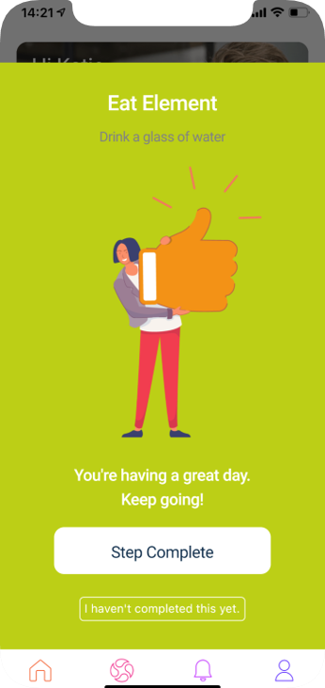
What’s the challenge about?
Using the all-new Pavelka app, you can experience daily wellbeing moments along with your own chosen team.
Everyone will share their journey with the CiscoPavelka community. Share your moments in the Pavelka app and see what your colleagues get up to!

Slide 4
What do we do in the challenge?
Each day, you and your teammates will each complete one well-being task – this will be suggested for you in the app.
Then, you will post about it in the community, and win a point for your team.

Slide 5
Where do we find the Pavelka app?
The new Pavelka app is available on your regular app store from the 17th of January.
Download the app, unlock it using the key CiscoHouse and sign in using your Cisco email address.
From there, click the challenge icon to enter the Global Challenge.

Slide 6
Sounds great – I’m in! Where do I find the full info
Go to http://go2.cisco.com/ciscopavelkaglobalchallenge
Read our How To page and the challenge FAQs for all the info you need to get started!

Slide 7
www.pavelkahouseforcisco.com

